Slide 1
BACK TO SCHOOL MISS MAZE’S CLASS
Kindergarten
Valley View Elementary

Slide 2
Welcome
Parent Handbook- Resourceful tool that has majority of the information about my classroom Please keep in a safe place!!
Manila Folder- Important forms that I need filled out and returned by Friday to help me know your child better!!
PTA Folder-Important information about Valley View and forms that need to be filled out and returned by Friday!!
First class to get 100% turned in will get a reward. We can do this. ☺
Transportation Forms- Please fill in how your child will be picked up to help with tomorrow running smoothly! ☺

Slide 3
Contact Information
Please check Class Dojo regularly.
This is how I and the school communicate important information and behavior.
You may email me through the school district email at b.maze@westside.k12.ca.us
You may also leave a phone message in the classroom by calling the school and dialing ext. 77315, even after hours.
I will be happy to arrange a conference before school (7:00) or after school (2:00).

Slide 4
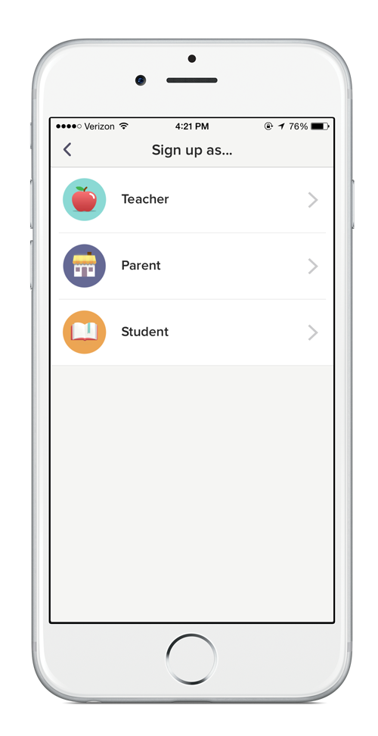
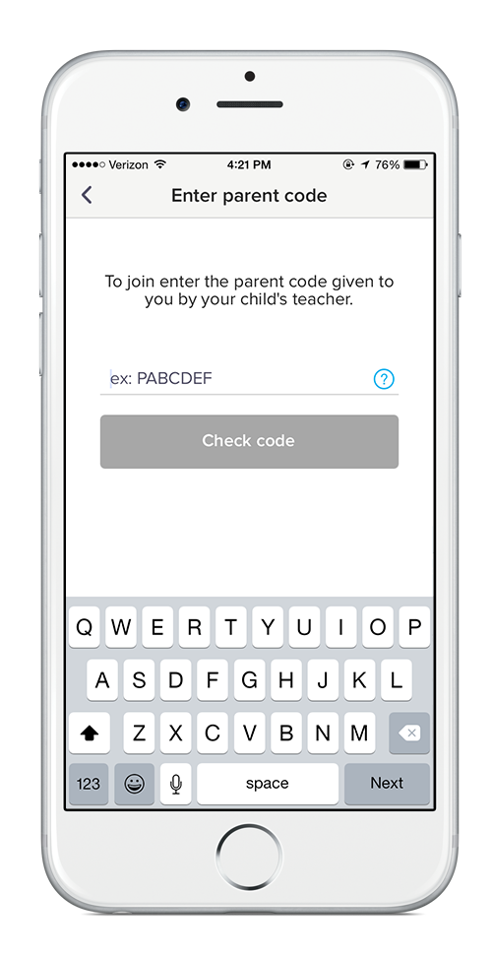
Code found in manila folder!
If we get 100% signed up, the class will get a reward!
Get important PTA and school information on the same app!!
Download the app
Sign up as a parent
Enter your code!

Slide 5
School Hours, Absences, and Dismissal
Class Begins 7:40 Tardies 7:45
Kindergarten students are dropped off at the Kinder gate in the L-8 parking lot or siblings can walk them to kindergarten playground.
Dismissal
Regular Day: 1:40 Minimum Day: 12:40
All Kindergarten students will be dismissed on 35th Street West.
Absences
Absences must be cleared!!!
Parent’s responsibility to notify the district when your child is absent by phone 722-0716 ext. 27900 or email vv.attendance@westside.k12.ca.us which includes date of absences and reason for absences.
You may send a note with your child.
The school will send notices for truancy if your student has frequent tardies or absences.

Slide 6
Breakfast, Recess, and Lunch
You may prepay your student’s lunch so they are not responsible for money each day. https://mypaymentsplus.com/
Breakfast $1.25 Lunch $2.70
Snacks should be separate from lunch boxes.
Please put your child’s full name on everything: snack, envelope with money, backpack, lunchbox, jacket, and water bottle. Empty backpack everyday!

Slide 7
Bathrooms and Water Bottles
Water bottle
Will not be using the sink in the classroom, so please send a water bottle
Label with their name!!
Do not allow bathroom breaks during my teaching unless it is an emergency
Children are encouraged to go before school, during recess. Lunch and afterschool.

Slide 8
Birthdays
Do not send invitations to school unless there is one for each of the students.
Birthdays at school will be celebrated on their birthday, so if parents wish to send in treats or join us.
Make sure to let me know if you plan on sending a treat in.
Please remember Healthy Kids program and food allergies.
If sending cupcakes, please send the small ones!! ☺

Slide 9
Star Student
Encourage positive behavior and build classroom community.
The Cat in the Hat will visit every home throughout the year when your student is “Star Student”.
Fill out “Star of the Week” page and return it, along with Dory, on Friday.
Students may also bring in pictures of themselves and their favorite book to be read to the class.

Slide 10
Homework/Communication Folder
Packets will be sent home at the beginning of the week.
Homework is turned in on Friday.
Take out and keep items on the Leave At Home side.
Homework folder will be provided for your child. Please take good care of it as they get one.
Keep folders in their backpack so that I can add flyers throughout the week as needed!

Slide 11
Supplies
Good-sized, sturdy backpack (non-rolling)
Over the ear headphones
White 1-ince view binder with a window in the front
Red, green, blue, yellow, and purple folder
Expo markers (black and color)
Hand sanitizer
Clorox wipes
Plastic page protectors
Printer ink cartridge canon PG 240/ CL241 or Canon
Treasure Box treats
Any other contributions are greatly appreciated!! ☺

Slide 12
Classroom Volunteers
I look forward to having parent volunteers in the classroom.
Please fill out the volunteer forms on the counter and I will be in contact with those that sign up.
The district requires fingerprinting for all classroom volunteers.
I’d appreciate a classroom parent to help with important events, to help organize and be in contact with other parents.

Slide 13
I am looking forward to a great year of growing and learning with your child and working as a team with all of you to make this a very successful school year!

